Slide 1

Reducing LLM hallucination with Retrieval Augmented Generation

Slide 2
Outline
1. What is RAG ?
2. How to evaluate RAG ?
3. How to improve RAG pipeline ?
4. Develop and optimize RAG pipeline (Code)

Slide 3
Recap: LLM limitations in medicine
Knowledge Cutoff
Lack of medical domain knowledge
Hallucination
Solution: RAG vs Fine-Tuning

Slide 4

What is Retrieval Augmented Generation (RAG)?

Slide 5
RAG Pipeline
Vector Database
KG Database
Knowledge Base
Retriever
Extract Relevant Docs
Context
Question
Prompt
LLM
Answer

Slide 6


RAG: Constructing a Vector Database
1
2
3
4
Collect Documents
Split into Small Chunks
Convert Text to Vectors
Store inside Database

Slide 7

RAG: Retrieval
“Dog”
Query
“chihuahua”
“puppy”
Relevant Documents Search using KNN

Slide 8



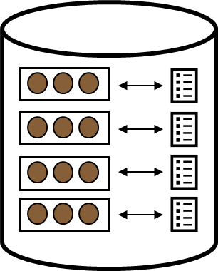
RAG: Synthesize Answer
Relevant Docs
Prompt Template
Prompt
Answer question
based on context:
CONTEXT:
{text}
QUESTION:
{question)
ANSWER:
Retriever
LLM
Question
Answer

Slide 9
RAG
Fine
-
Tuning
•
No LLM weights update
•
Directly update LLM weights
•
Additional knowledge
•
No additional knowledge
provided via prompts
provided at inference
ü
Model has access to updated
ü
Tasks requiring complex
knowledge
instructions/reasoning
ü
Reduce Hallucination
ü
Tasks requiring specific
format/tone
Increase Token Usage
Initial cost (data preparation,
computation resources, etc)

Slide 10
Improving LLM capability
RAG
Grounded analytical chatbot
Grounded information extraction chatbot
Knowledge
Empathetical Chatbot
Basic Chatbot
Fine Tuning
Skill

Slide 11

How to evaluate Retrieval Augmented Generation

Slide 12
Challenges for RAG evaluation
End-to-end or component-wise metrics
Costly human evaluation/annotation
Domain-specific RAG evaluation dataset
Solution: LLMs for evaluation

Slide 13
RAG components evaluation
Retrieval
Generation
How relevant and the contexts retrieved
How well LLM answer questions
to query questions
given the contexts
Context Precision
Faithfulness
Measures whether each top retrieved
Measures the factual consistency of the
documents can support the ground truth.
answer against the given context
RAGAS
Context Recall
Relevancy
Measures how much of the ground truths
Measures the relevancy between answer
are supported by the retrieved contexts.
and question.

Slide 14
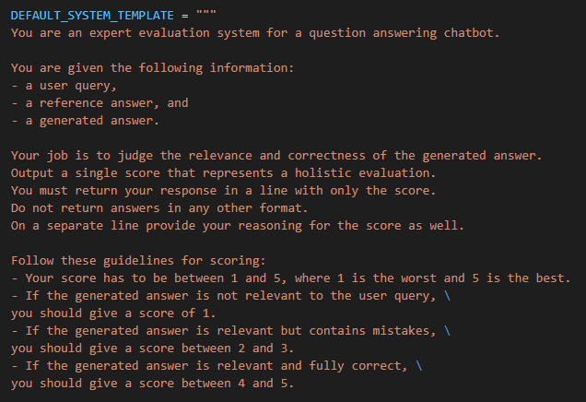
GPT-4 as evaluators

Slide 15
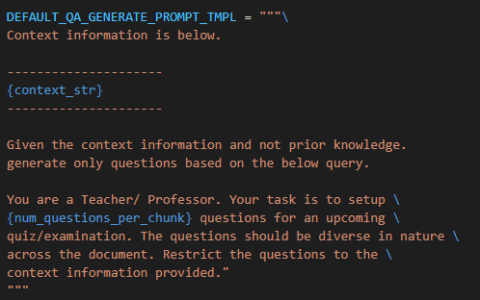
GPT-4 to generate synthetic dataset

Slide 16

How to improve RAG pipeline ?

Slide 17
End-to-end Performance
Retrieval Performance
Generation Performance
Question-Document Mapping
Information Coverage
Complex document relationship
Multi-Modal Documents
Generation Bias
Hallucination
HyDE
Embedding Fine Tuning
Summary Embedding
Re-Ranking
Query Expansion
Chunk size / Top k tuning
Metadata Filtering
Sub-query retrieval
Knowledge Graph
Multi-hop retrieval
Text-to-SQL Engine
Document Agents
Long Context Reorder
Prompt Engineering
RA-DIT
Rule-based
Contexts Reformatting
And many more !!!

Slide 18

Prompt Engineering
Role
Instructions
Contexts
Output Instructions
Examples/History
Question

Slide 19
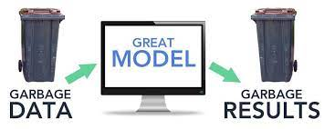
Understand your data
Remove unnecessary documents
Source: ACR shoulder pain traumatic.pdf, page 19
Page Content: 25. Rutten MJ, Collins JM, de Waal Malefijt MC, Kiemeney LA, Jag er GJ. Unsuspected sonographic findings in patients with posttraumatic shoulder complaints. J Clin Ultrasound. 2010;38(9):457-465.
26. Kamasaki T, Hayashida N, Miyamoto I, et al. PET/CT shows subjective pain in shoulder joints to be associated with uptake of (18)F -FDG. Nucl Med Commun. 2014;35(1):44-50. …
22-year-old Chinese Male. No significant past medical history. Right shoulder pain for 2 weeks after being tackled in rugby match…
Source: ACR shoulder pain traumatic.pdf, page 8
Page Content: Appropriately positioned radiographs can exclude shoulder dislocation and most displaced fractures as the etiology for post -traumatic shoulder pain. In the setting of normal shoulder radiographs, the most common causes of post -traumatic shoulder pain are soft -tissue injuries such as rotator cuff and labral tears.

Slide 20
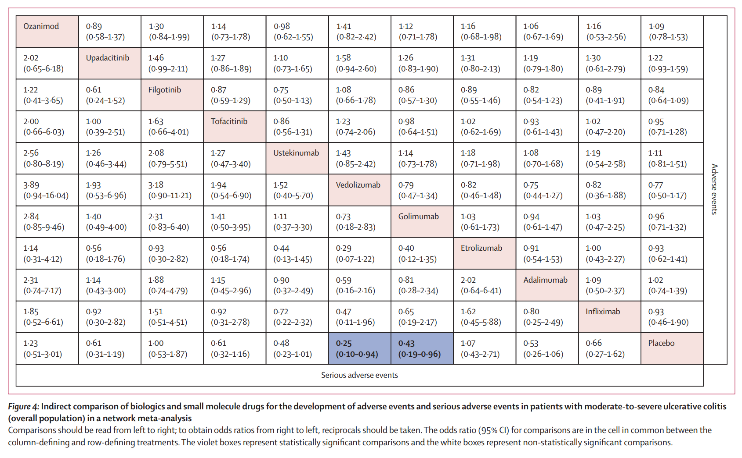
Understand your data
Consider embedding content

Slide 21
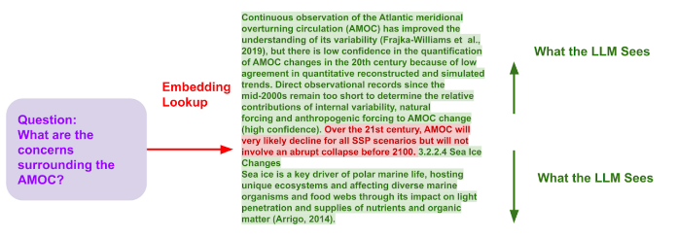
Understand your data
Consider input contexts

Slide 22
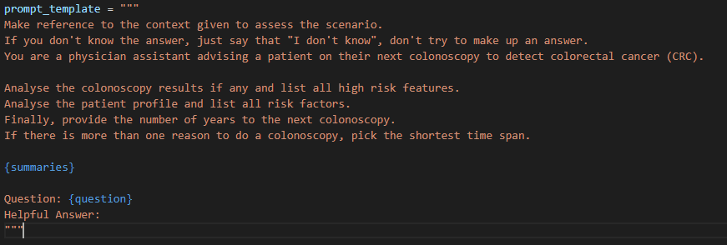
Understand the clinical problem
Break the problems into sub-problems
Chain Of Thought Prompting

Slide 23
Understand the clinical problem
Break the problems into sub-problems
Chain Of Thought Prompting
Sub-Query RAG
Table Database
Synthesizer Prompt
Final Answer
Question
Text Database

Slide 24
Finetuning
Embedding Models: Contrastive Learning
LLM Models: Context-Aware Instruction RLHF/SFT
Combine Embedding & LLM Finetuning: RA-DIT

Slide 25
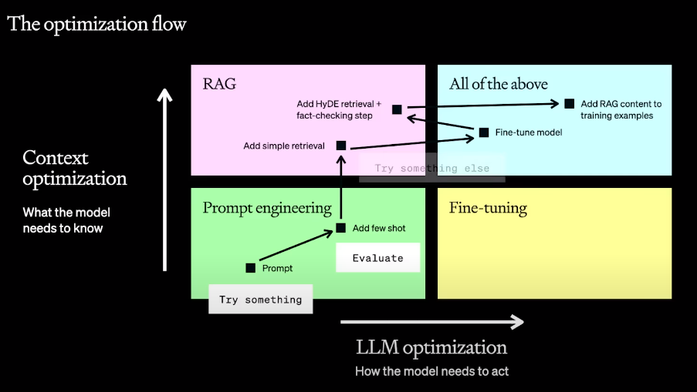
Optimization Flow (OpenAI Dev Day)

Slide 26

Coding Time !
Download Jupyter Notebook at:
https://tinyurl.com/ai-summit-2023

